Slide 1
SEARCHING & SORTING Application in Data Science
Prashant Roy

Slide 2
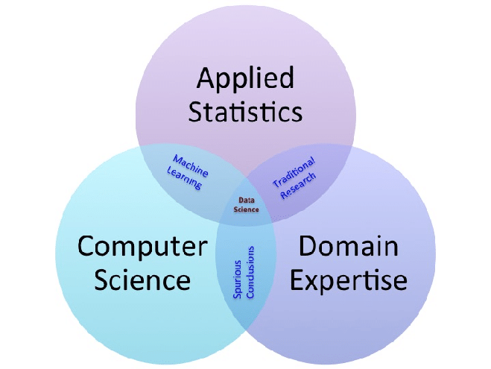
The Data Science Venn Diagram
Algorithms
Search
Sort
Notes:
The venn diagram needs to be recreated

Slide 3
There are some very common problems that we use computers to solve:
Searching for a specific record or set of records through a big data with lot of observations
Placing observations in order, which is called sorting
Common Problems
Notes:
Search Problems – Faster implementation when lists are sorted
Item Selection - Example: Calculating median in a list
Redundancy - Identifying repeat entries is quick
Distribution - Frequency distribution is blazing fast

Slide 4
A question when selecting a search algorithm is “How fast does the search have to be?” The reason is that, in general, the faster the algorithm is, the more complex it is
Bottom line: you don’t always need to use or should use the fastest algorithm.
Challenge

Slide 5
Application to Data Sciences

Slide 6

Analytics Life Cycle
Data Cleaning and Preparation
Exploration and Visualization
Model Development
Model Management
Search & Sort
Search & Sort
Search & Sort
Source Data

Slide 7
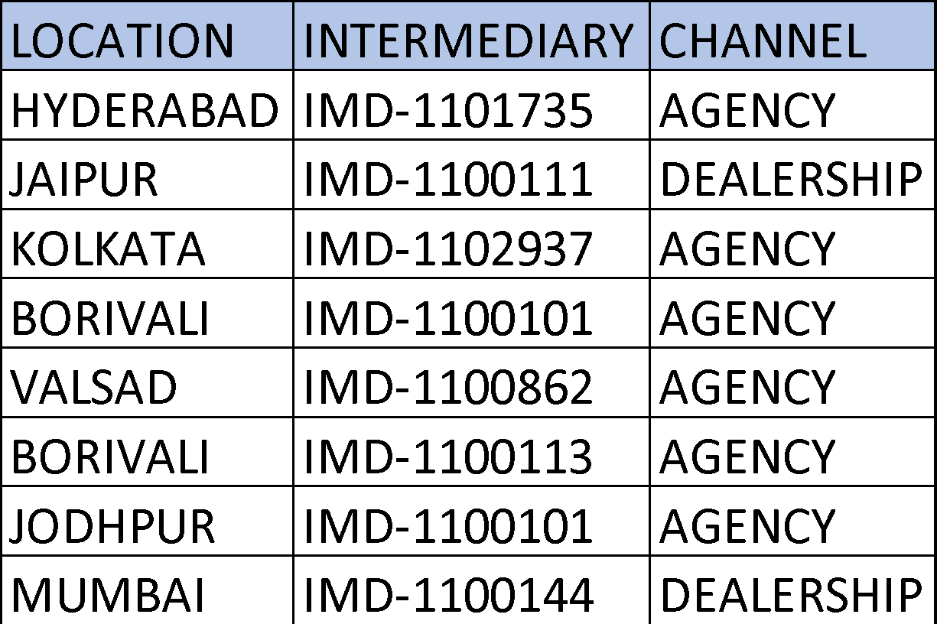
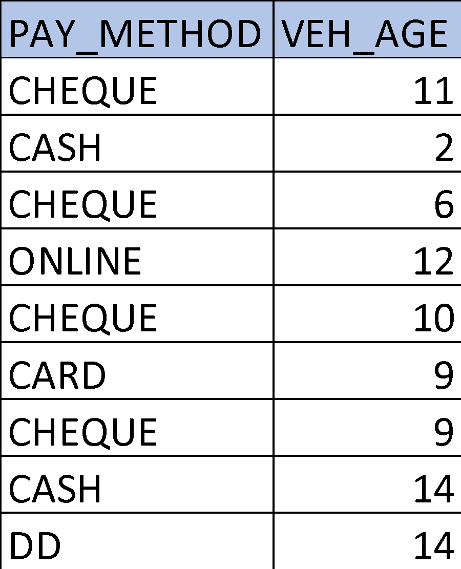
Data Cleaning and Preparation
1
“Searching” the missing value and imputing it
2
“Searching” and filtering the dataset/dataframe
3
“Sorting” and filtering the dataset basis conditions (VEH_AGE > 10)
Notes:
brute force approach vs search and sort, explain interms of time complexity
Tim sort is used in Pandas - Combination of insertion and merge
Sorted list takes less time than the linear search

Slide 8
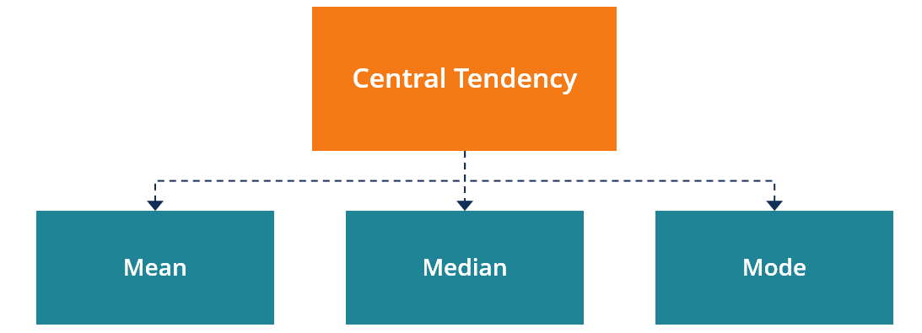
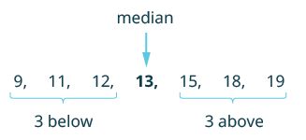
Exploration and Visualization
Univariate Statistics
Data must be sorted before finding MEDIAN
Notes:
The above 2 images needs to be recreated
Quick sort is generally used for finding median

Slide 9
Exploration and Visualization
Hypothesis Testing
Wilcoxon Rank Sum Test
Number of Episodes of Shortness of Breath
Placebo | 7 | 5 | 6 | 4 | 12
New Drug | 3 | 6 | 4 | 2 | 1
Question: Is there a difference in the number of episodes of shortness of breath in participants receiving the new drug as compared to those receiving the placebo?
By inspection, it appears that participants receiving the placebo have more episodes of shortness of breath, but is this statistically significant?
Notes:
The table image needs to be recreated
More dataset examples - like rent in delhi mumbai
Variable importance test

Slide 10
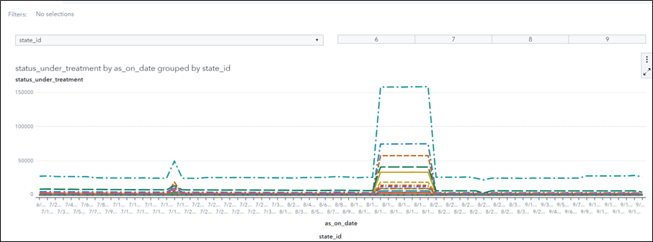
Exploration and Visualization
Dashboard
Notes:
No change required

Slide 11
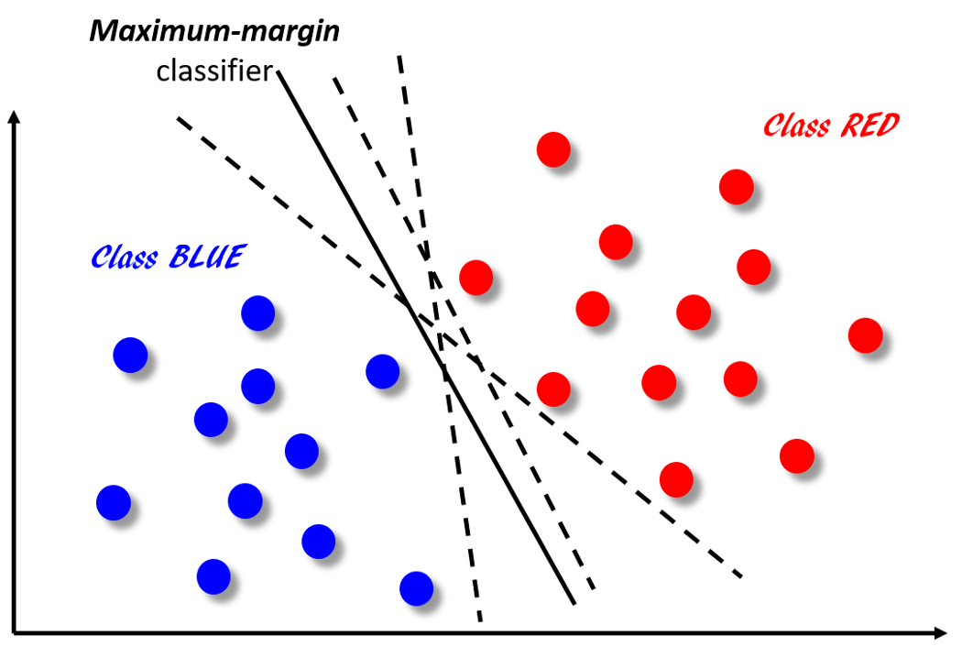
Machine Learning Algorithm Support Vector Machine
This is a Binary classification Problem
The two targets are Blue and Red
Notes:
Image needs to be recreated
Source: https://towardsdatascience.com/how-the-good-old-sorting-algorithm-helps-a-great-machine-learning-technique-9e744020254b

Slide 12
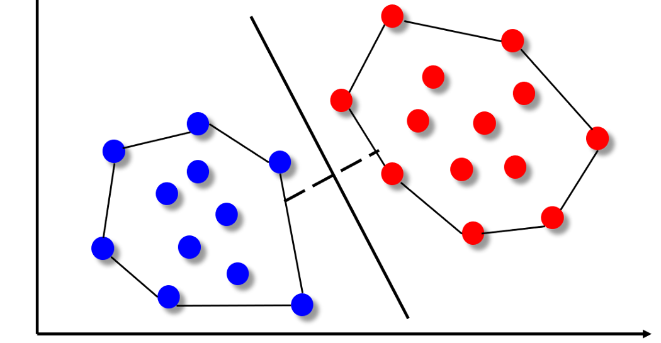
Machine Learning Algorithm Support Vector Machine
The formal mathematics behind the SVM algorithm is fairly complex but intuitively it can be understood by considering a special geometric construct called convex hull
Notes:
Image needs to be recreated

Slide 13
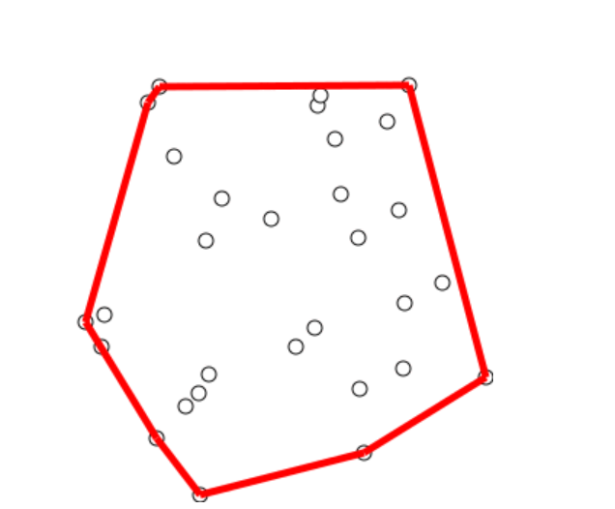
Machine Learning Algorithm Support Vector Machine
Graham Scan to find out “Convex Hull”
The time complexity of Graham’s scan depends on the underlying sort algorithm that it needs to employ for finding the right set of points which constitute the convex hull
sorting algorithm is at the heart of solving an important problem in computational geometry and how that relates to a widely used machine learning techniques
Notes:
Image needs to be recreated
Merge sort / Heap sort is generally used in Graham scan

Slide 14
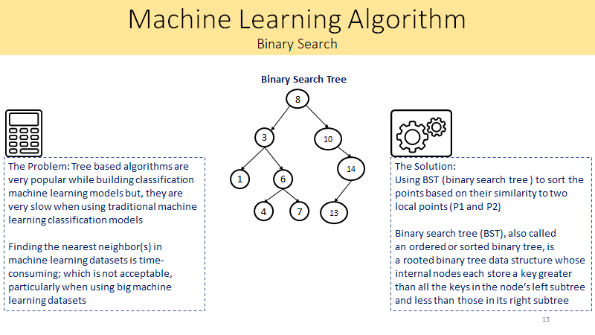
Notes:
NLP and n-grams uses BST. No need of image recreation

Slide 15
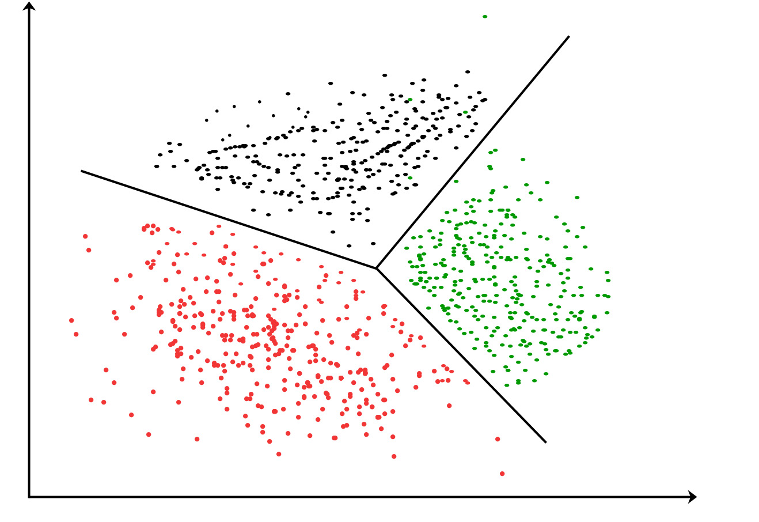
Machine Learning Algorithm Clustering
Un-Supervised Clustering
Distance between points and centroid must be sorted to label them with cluster ID
Notes:
Image needs to be recreated
Quick sort and bubble sort are used

Slide 16
Conclusion
In practice, most of “search and sort” operations are done by using pre-built libraries, however understanding the internal working/mathematics of data analytics algorithms, Conceptual knowledge of “Search and Sort” is a must

